Slide 1
Cryptocurrency Trend Analysis
Using Data Visualization
BCA AI & DS
Riyaz Ahamed S
Rohith Kumar R
Sunil Kumar S
Rishi Keshan G
Sakthi Niranjan S

Slide 2
Introduction
▸ Cryptocurrency is a decentralized digital currency secured by blockchain technology
▸ Rapid price fluctuations make manual tracking unreliable and time-consuming
▸ Trend analysis reveals market behavior, investment patterns, and risk indicators
▸ Data visualization transforms raw financial data into actionable insights

Slide 3
Problem Statement
▸ Cryptocurrency prices fluctuate rapidly — often by 10–30% within hours
▸ Manual monitoring of multiple assets across time is impractical at scale
▸ Raw tabular data makes it difficult to spot patterns, correlations, or anomalies
▸ A systematic visual analytics approach is needed for reliable interpretation

Slide 4
Objectives
▸ Analyze historical cryptocurrency price trends across BTC, ETH, and DOGE
▸ Compare cross-asset market performance over time
▸ Visualize price movement using trend and moving average charts
▸ Study trading volume patterns to identify activity spikes
▸ Understand market relationships through correlation analysis

Slide 5
Technologies Used
▸ Python — Core programming language for data analysis and scripting
▸ Pandas — Data manipulation and time-series processing
▸ Matplotlib — Static and interactive chart generation
▸ Seaborn — Statistical data visualization library
▸ yFinance — Real-time and historical cryptocurrency data via Yahoo Finance API
▸ Google Colab — Cloud-based notebook environment for development

Slide 6
Methodology
▸ Data Collection — Fetch historical OHLCV data using yFinance API
▸ Data Cleaning — Handle missing values, normalize formats, filter outliers
▸ Trend Analysis — Apply moving averages and rolling statistics
▸ Visualization — Build charts: line plots, bar charts, histograms, heatmaps
▸ Comparison — Cross-asset analysis of BTC, ETH, and DOGE
▸ Result Interpretation — Extract insights and summarize findings

Slide 7
Visualizations Used
▸ Price Trend Graph — Line chart of closing prices over time
▸ Moving Average Analysis — 30-day & 90-day SMA overlay on price chart
▸ Trading Volume Analysis — Bar chart comparing average trading volumes
▸ Histogram — Bitcoin price distribution across frequency bins
▸ Correlation Heatmap — Pearson correlation matrix of asset returns
▸ Daily Returns Analysis — Percentage change time-series for volatility insight

Slide 8
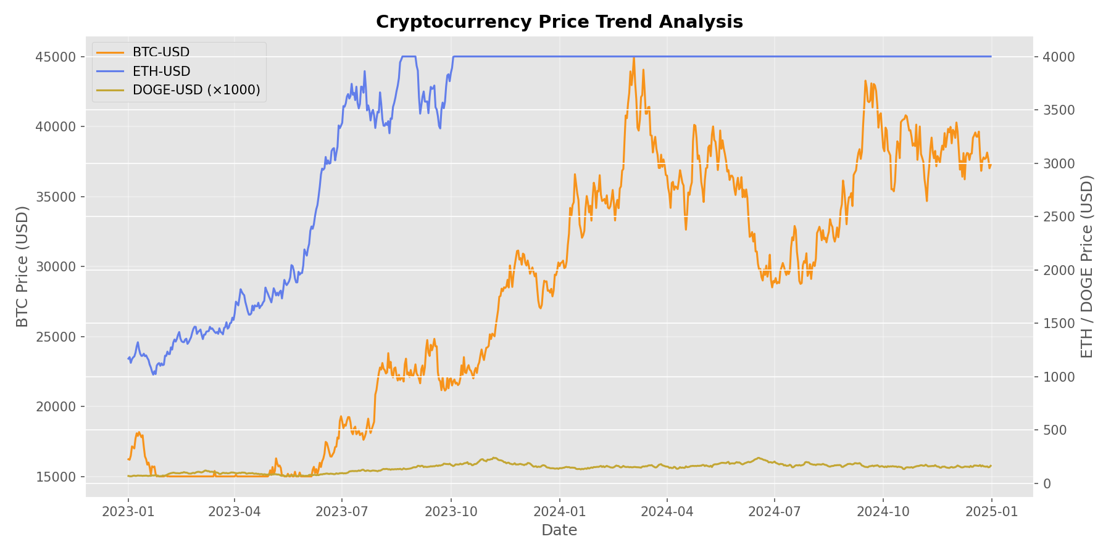
Price Trend Analysis

Slide 9
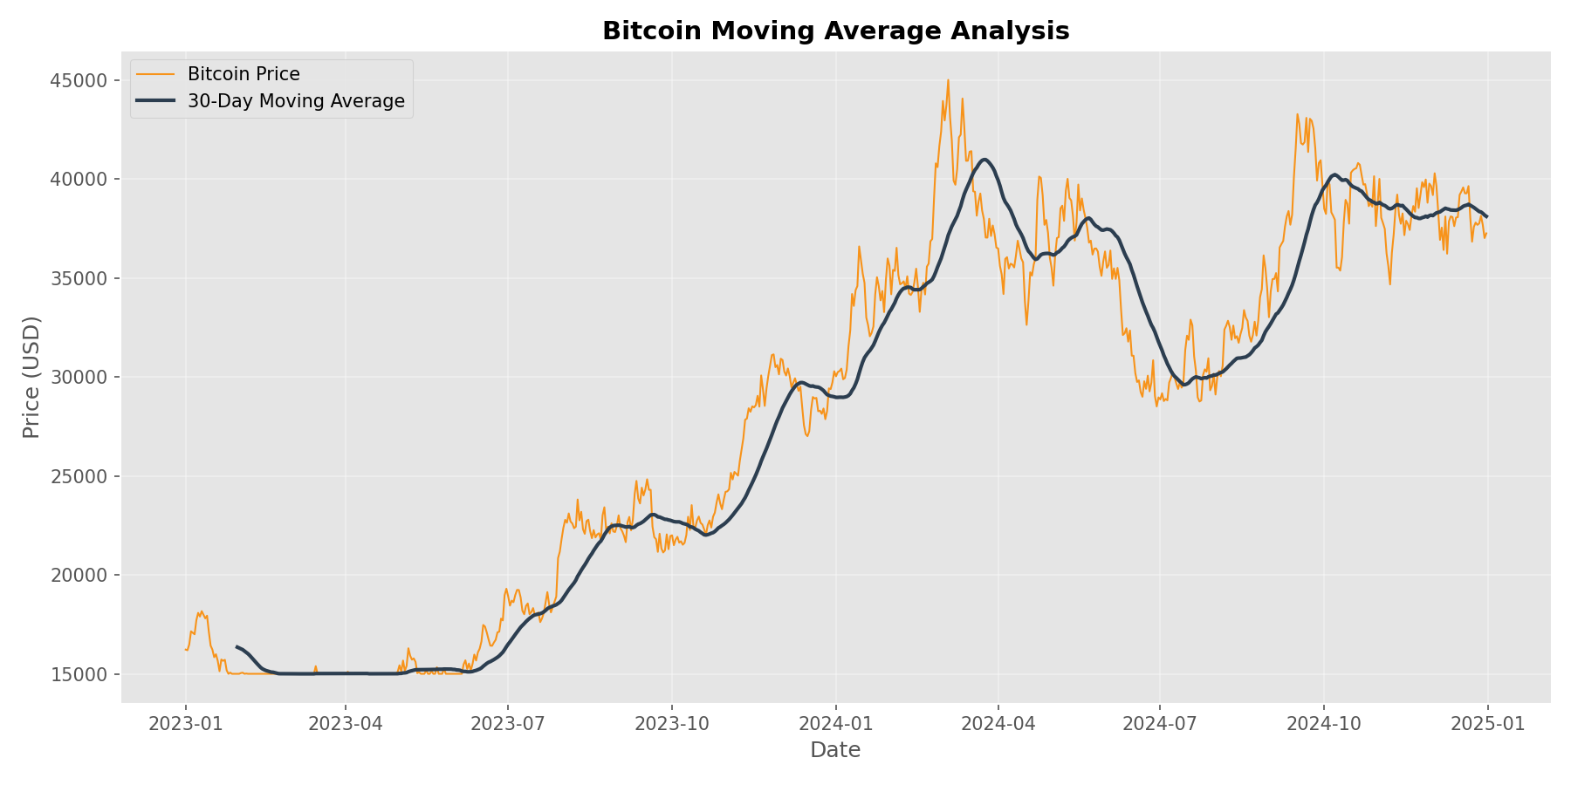
Moving Average Analysis

Slide 10
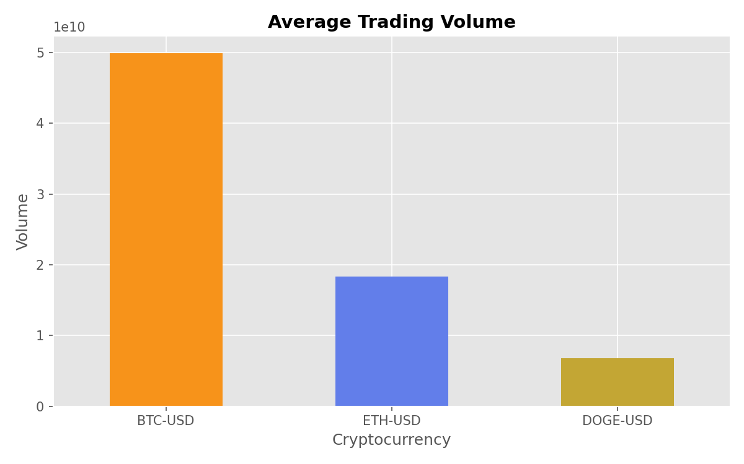
Trading Volume Analysis

Slide 11
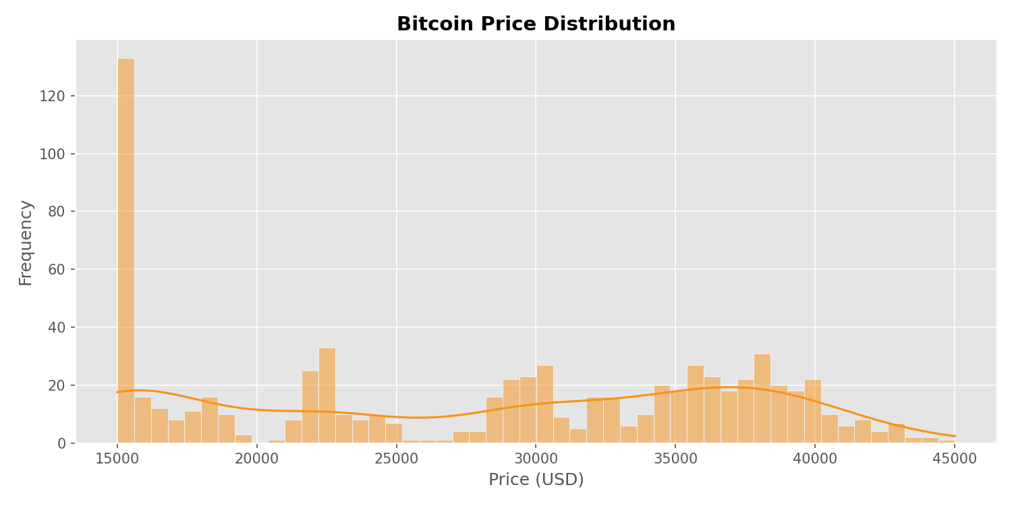
Bitcoin Price Distribution

Slide 12
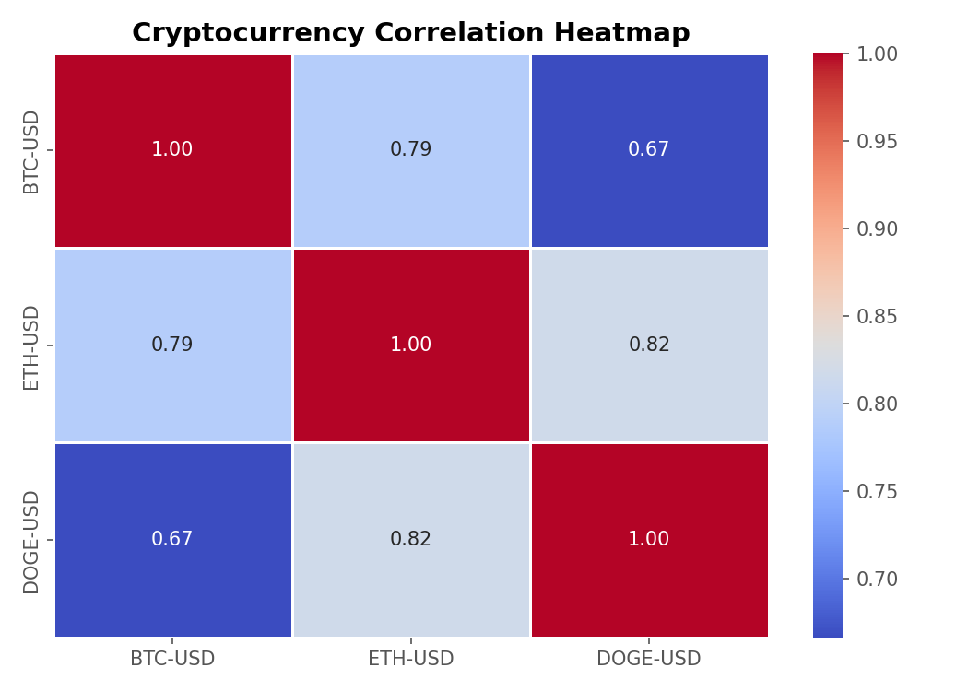
Cryptocurrency Correlation Heatmap

Slide 13
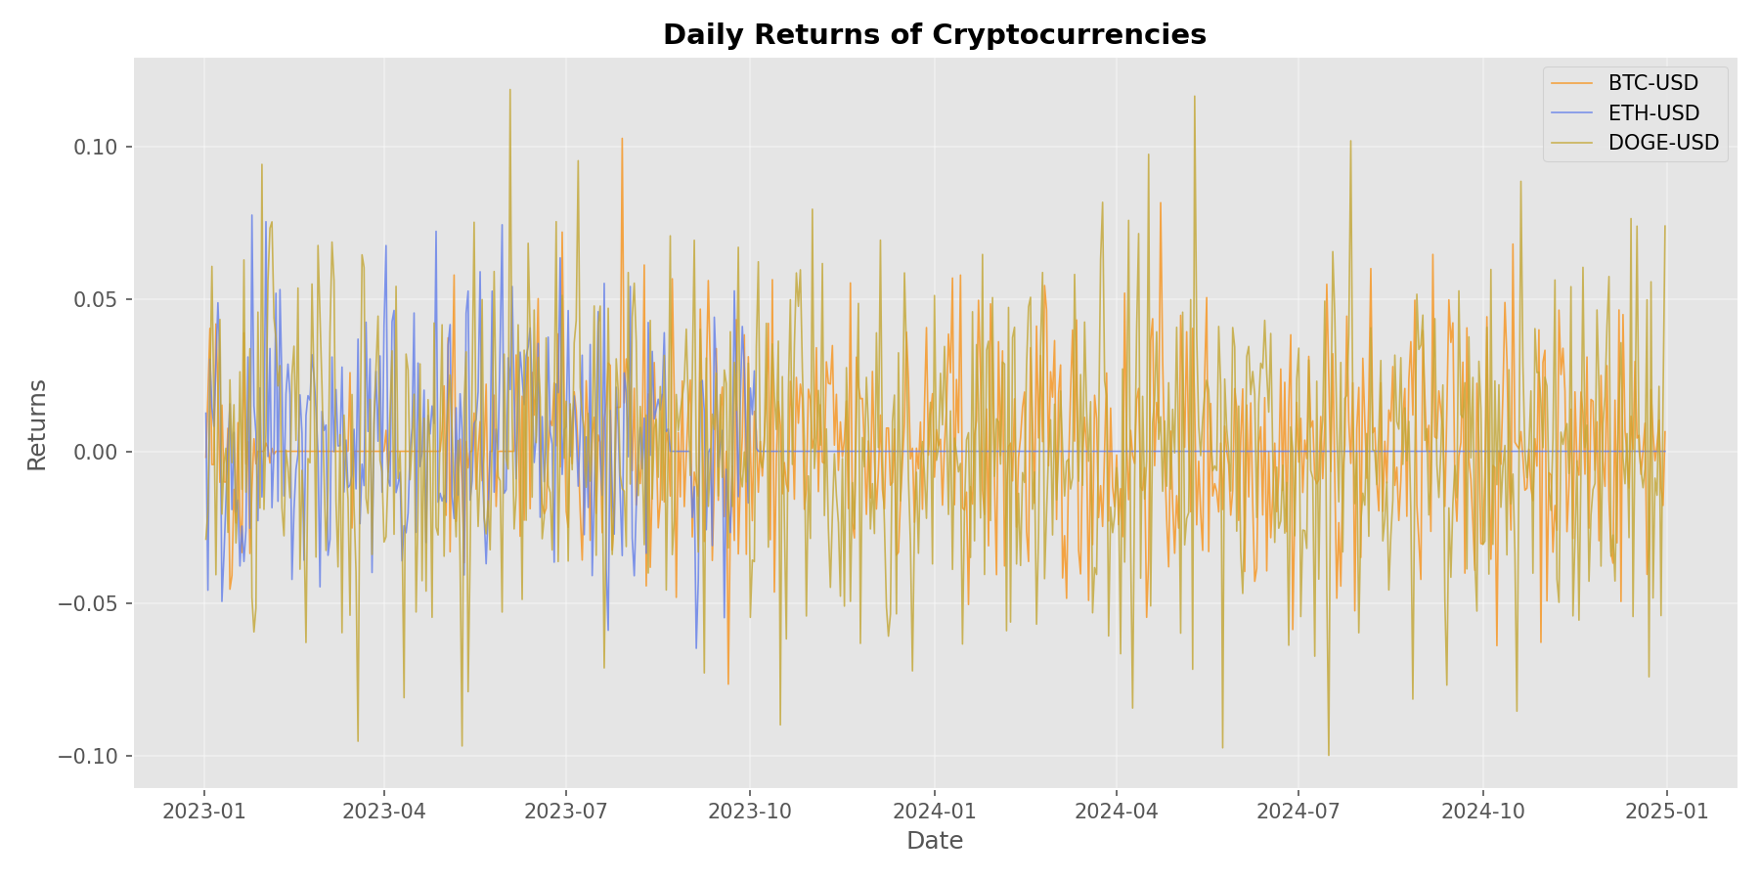
Daily Returns Analysis

Slide 14
Results
▸ Bitcoin showed dominant price growth with high volatility during 2020–2021
▸ Ethereum demonstrated strong positive correlation with Bitcoin (r = 0.79)
▸ Dogecoin exhibited extreme short-term spikes driven by social media trends
▸ Moving averages confirmed trend reversals and support/resistance zones
▸ Trading volume spikes aligned with major price movements and market events
▸ All three assets showed elevated daily return variance, confirming high risk

Slide 15
Conclusion
▸ Data visualization is essential for interpreting volatile cryptocurrency markets
▸ Moving averages and correlation analysis provide reliable technical signals
▸ Python + Pandas + yFinance form a powerful open-source analytical stack
▸ Visual analytics supports better-informed, data-driven investment decisions
▸ Future work: extend to real-time dashboards and predictive ML models

Slide 16
Thank You
Questions & Discussion Welcome
Riyaz Ahamed S | BCA AI & DS | Cryptocurrency Trend Analysis Using Data Visualization

